Slide 1
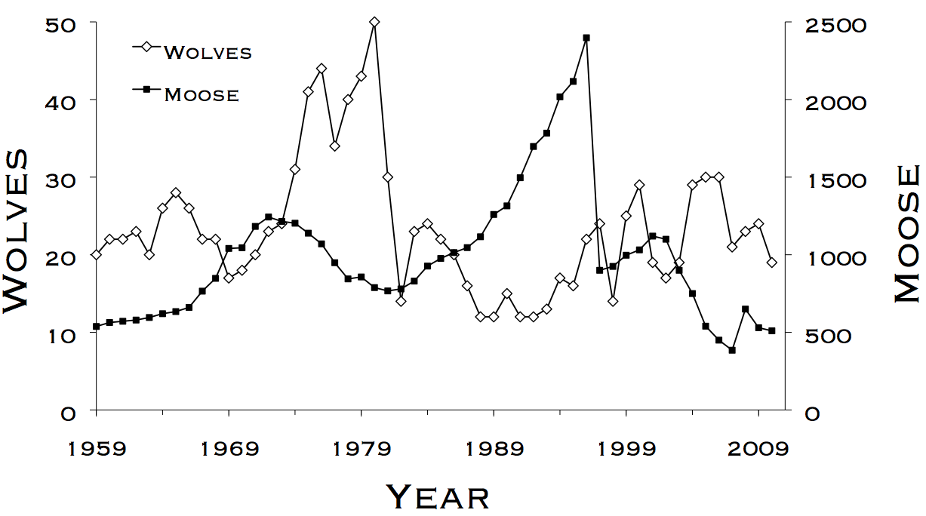
Lab 7 – Known Fate 2
WLE 411, Week 12

Slide 2
Course review
Revisions
Changes to due dates- see Brightspace
No revisions for Labs 8 and 9
Submit as an email to Marcos

Slide 3

Last week- Categorical variables
Difference in survival between sexes
Intercept (baseline survival)
$$logit\left(S\right)=β_{Sex}∗Sex+β_{0}$$
Interval survival, transformed by a link function
Sex (categorical variable expressed as 0s and 1s)

Slide 4
Continuous variables
Difference in survival with each increment of precipitation
$$logit\left(S\right)=β_{precip}∗Precip+β_{0}$$
Continuous numeric variable

Slide 5
Continuous variables
$$logit\left(S\right)=β_{precip}∗Precip+β_{0}$$
$$logit\left(S\right)=−0.2∗0.5in+β_{0}$$
Rain in a given month

Slide 6
Continuous variables
$$logit\left(S\right)=β_{precip}∗Precip+β_{0}$$
$$logit\left(S\right)=−0.2∗0.5in+β_{0}$$
For every additional in of rain, survival decreases by 0.02

Slide 7
Comparing continuous covariates
We have two continuous covariates
Precipitation- survival decreases by 0.2 for every inch of rain
Temperature- survival increases by 0.01 for every degree of temperature
Both covariates are on different scales
Precipitation varies by ±0.5 inches each month
Temperature varies by ±20 degrees
Can we compare the magnitude of their effects on survival?

Slide 8
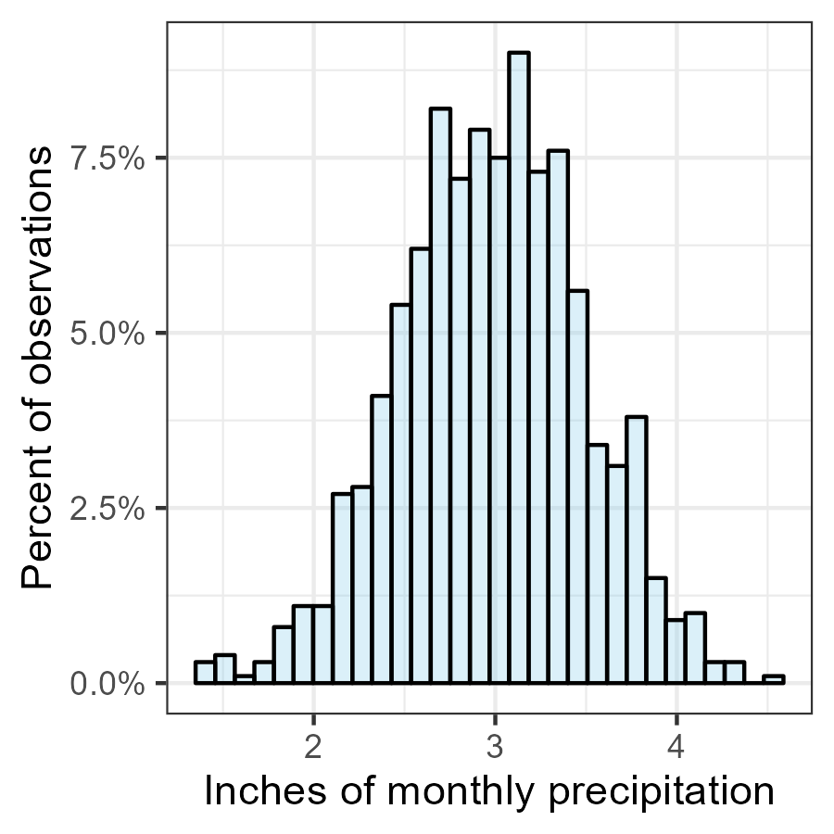
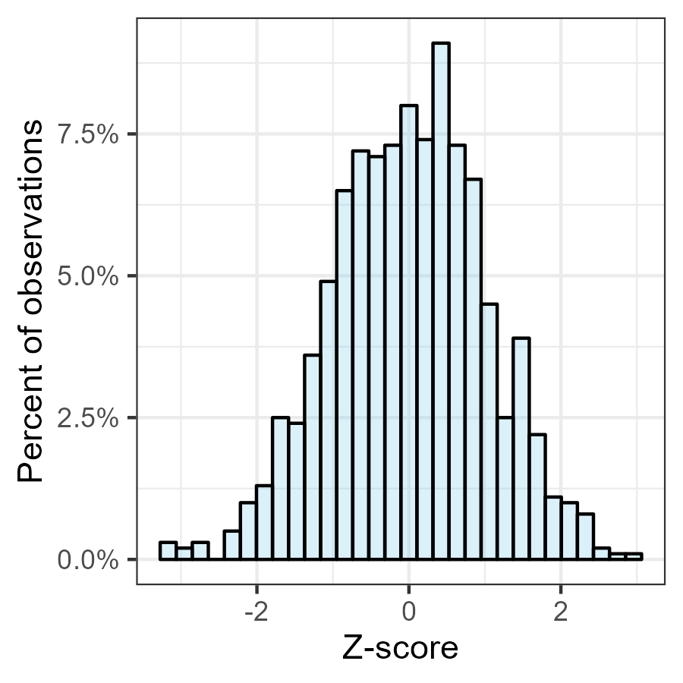
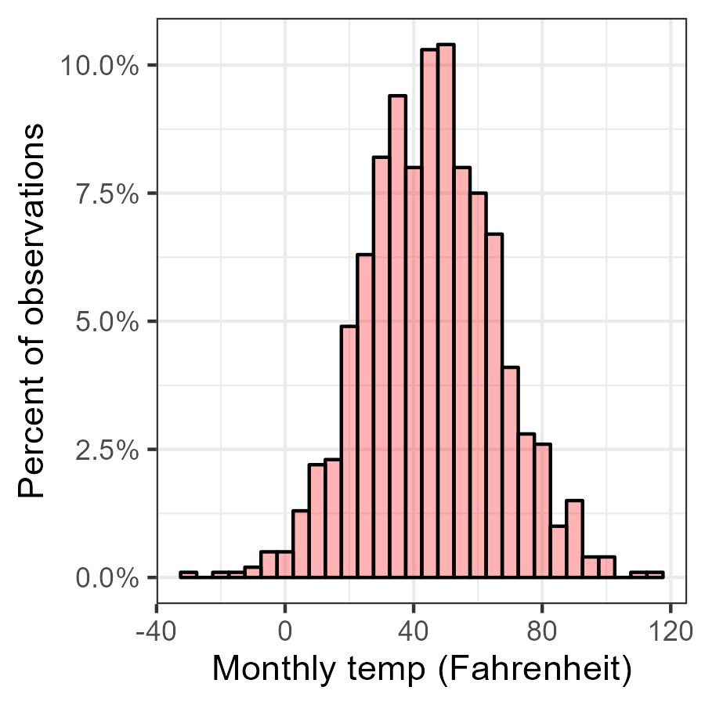
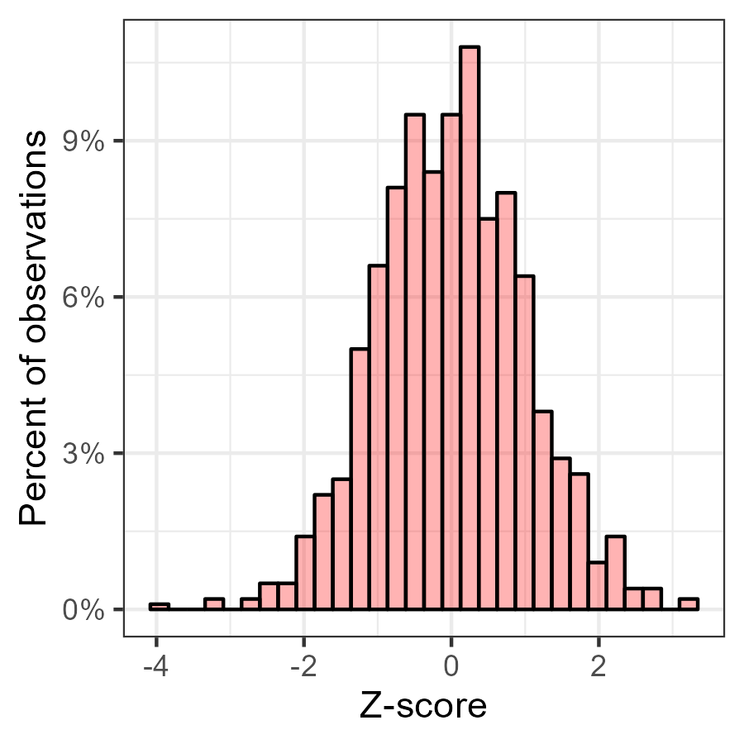
Notes:
Z-standardization
Taking covariates with different scales, such as inches of precipitation and degrees, and putting them on a common scale
Z-standardized distributions have two common characteristics:
- Mean of 0
- Standard deviation of 1
After z-standardization, the betas of our continuous covariates are comparable

Slide 9
Z-standardization
Taking covariates with different scales, such as inches of precipitation and degrees, and putting them on a common scale
Z-standardized distributions have two common characteristics:
Mean of 0
Standard deviation of 1
After z-standardization, the betas of our continuous covariates are comparable
Notes:
Taking covariates with different scales, such as inches of precipitation and degrees, and putting them on a common scale
Z-standardized distributions have two common characteristics:
- Mean of 0
- Standard deviation of 1

Slide 10
Assignment
Write up a Results section including your results for Labs 6 & 7
This has historically been a difficult assignment
Ensure that every sentence ending with a ? in the assignment text is addressed in your results
Choose figures and tables that you think support your results, and follow formatting conventions
Due in two weeks, but don’t wait until the last minute

Slide 11
Assistance
No office hours on Thanksgiving week
Don’t hesitate to send emails if you have questions, but responses may be delayed during the break

